Slide 1
GridGPT 2.0: AI Virtual Assistants for Smart Grid Applications
SDMay25-42
By: Ian Bussan, Aditi Nachnani, Luke Eitzmann, Ian Louis, Scott Rininger
Client & Advisor: Dr. Ravikumar Gelli
Notes:
Ian Louis
Number the slides, upload all the code, ensure code is working in the vms, once it is done message Dr. Gelli
Wear formals - can do mock practices

Slide 2
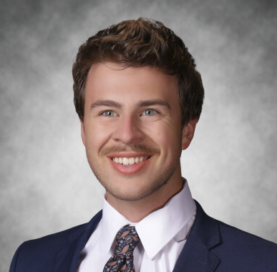
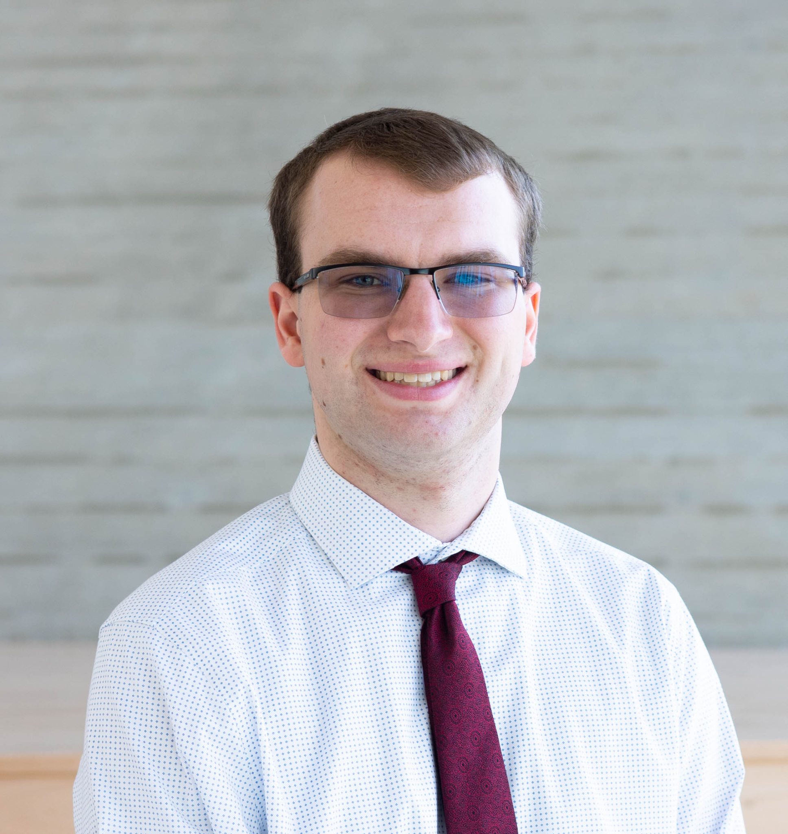
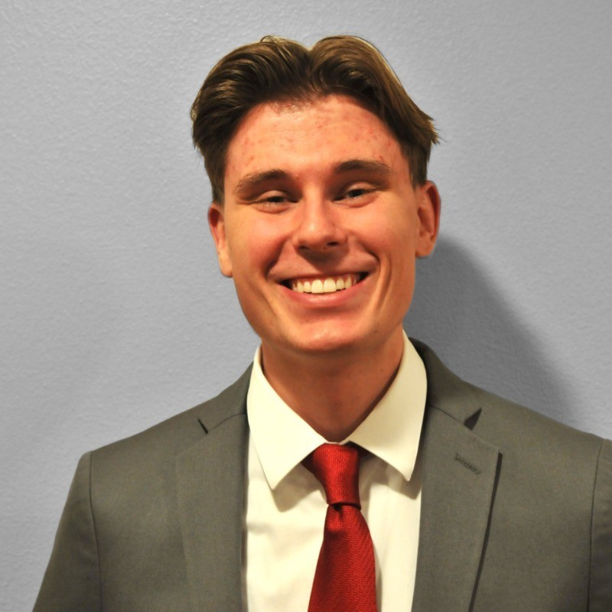
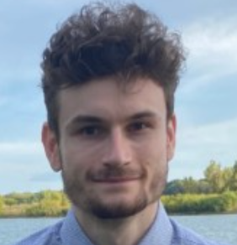
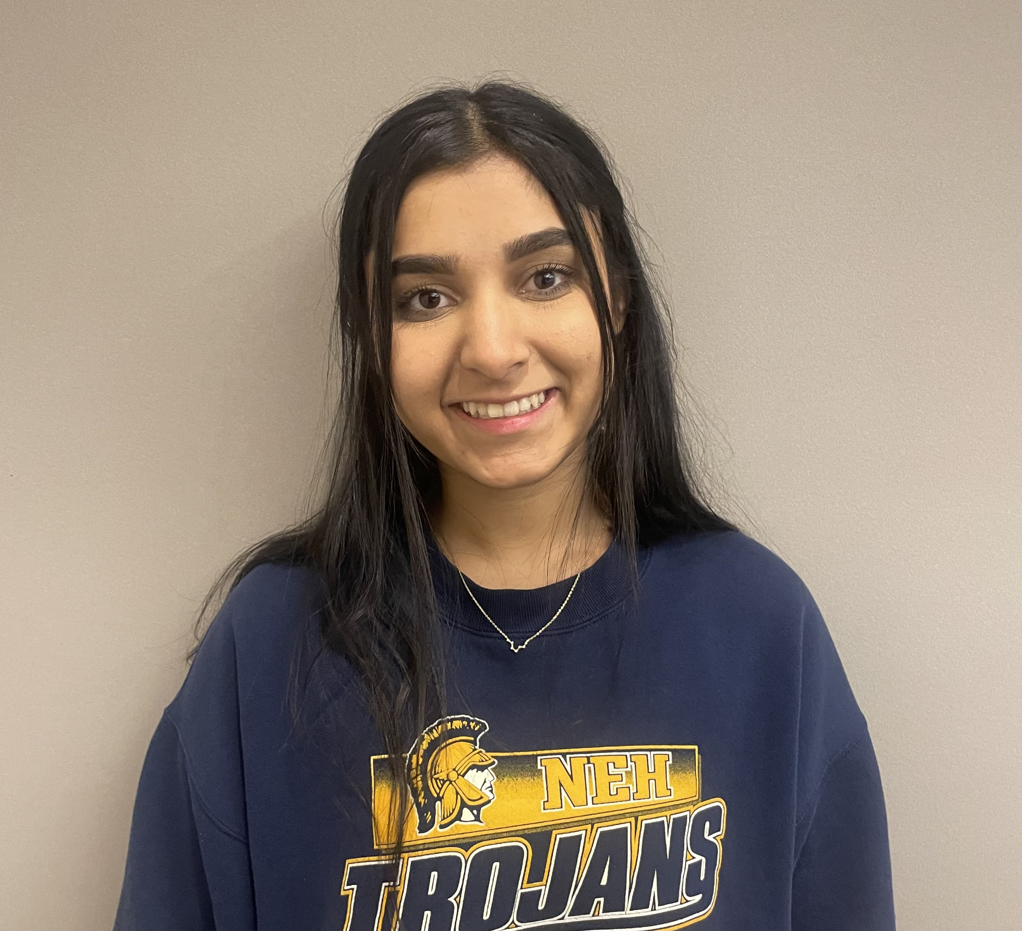
Grid Team
AI Team
Luke Eitzmann
Power Co-Lead
Scott Rininger
Power Co-Lead
Ian Louis
Power Co-Lead
Ian Bussan
AI Co-Lead
Aditi Nachnani
AI Co-Lead
Notes:
Ian Louis

Slide 3
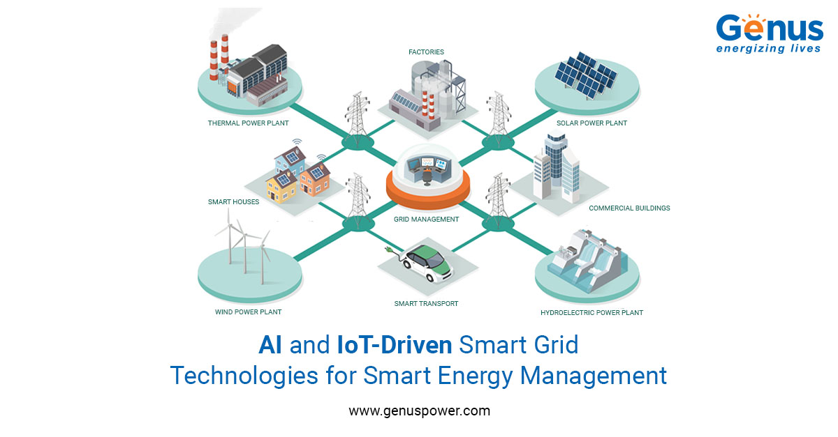
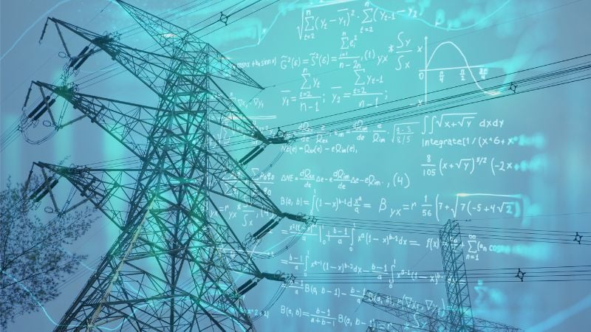
Project Overview
Develop an AI-driven virtual assistant that integrates with GridAI
Assists users with understanding complex electric power grid data to make well informed decisions
GridAI: a software application that provides users with information about their power distribution systems.
Notes:
Louis Explain what grid AI is

Slide 4
Problem Statement
Changing landscape
Fast and dynamic
Distributed Energy Resources (DERs)
Traditional software struggles to keep up
GridGPT 2.0
Meets the changing landscape
Edits and generates DSS scripts
Reduces errors
Increases efficiency
Notes:
Scott

Slide 5
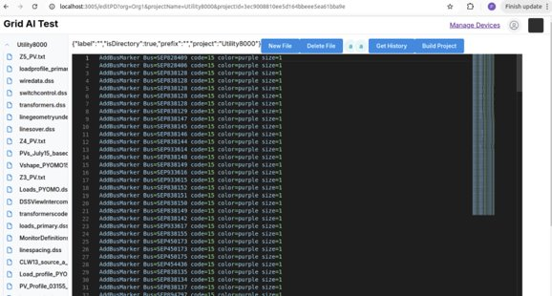
GridAI
An analytics software application created by Dr. Gelli at ISU
Provides insights in power consumption using AI
Real time grid visualization, analysis, and management
Interacts with the power distribution modeling software OpenDSS
Notes:
Scott - say its a software architecture we will be adding virtual assistance to it-Done

Slide 6
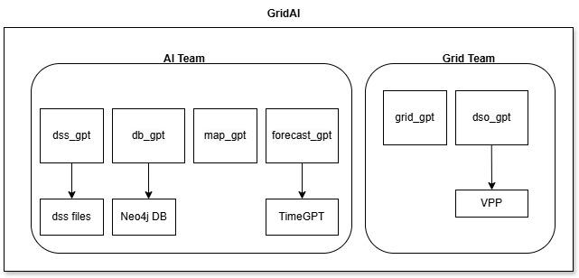
GridGPT 2.0
Extend GridAI by building specialized AI assistants using OpenAI’s API
Notes:
Aditi, Explain the GPTs more in the diagram, show how the different GPTs interact , say this is a software project

Slide 7
Market Research
Notes:
Luke

Slide 8
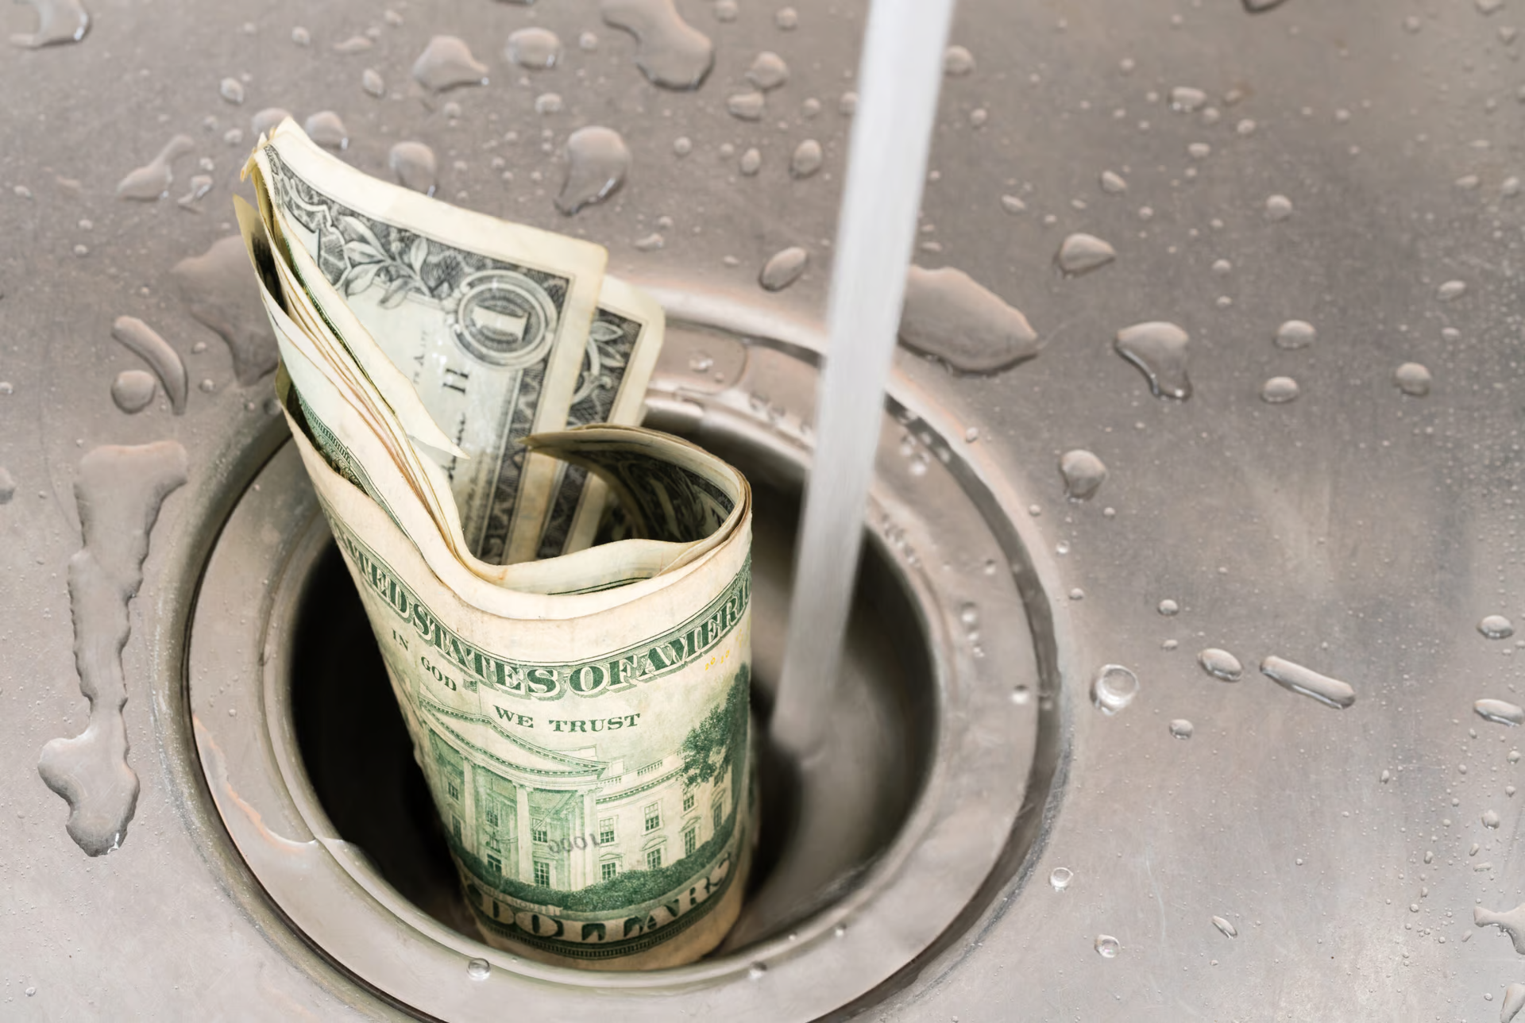
Market Gap
Expensive Software
Complicated and Hard to Learn Software
Lack of AI integration into Power System Software
Notes:
Louis

Slide 9
Functional Requirements
Must interact with GridAI to retrieve, process, and present grid data to users
Must be able to interact with grid modelings software like OpenDSS
Must comply with engineering standards
Shall ensure personal data can only be accessed by authorized users
Notes:
Louis, say that we are designing the GPT models, show single GPT approach vs 6 GPT approach and why we need 6 GPTs, after this slide explain how the GPTs interact with gridAI

Slide 10
Non-Functional Requirements
Performance
The system should be able to process natural language queries and produce responses within a few seconds.
The system should handle multiple threads of user requests without significant degradation in performance.
Scalability
The system should accommodate an increasing number of users and grid complexity
Usability
The system must be easy to use and allow users of varying technical skills to interact with the system effectively
Notes:
Louis

Slide 11
Project Planning
Notes:
Louis

Slide 12
Why 6 GPTs
Having multiple GPTs allows us to fine tune each GPT for its specific task
Notes:
Louis

Slide 13
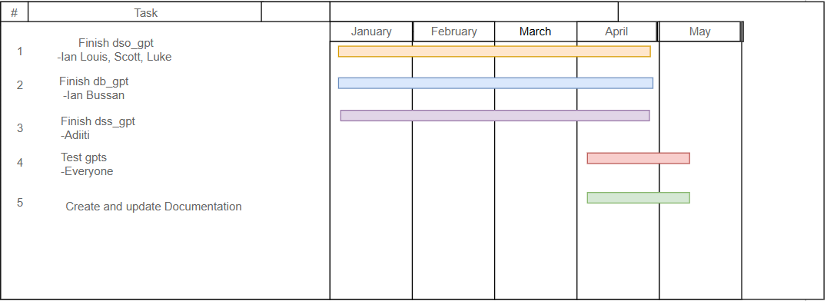
Project Plan
Notes:
Luke, make the font in the diagram bigger

Slide 14
Key Risks and Risk Mitigations
Risks | Risk Mitigation
Data Privacy and Security System Reliability Integration Challenges | Limit exposure to third-party components Implement monitoring, fallback mechanisms, and regular testing Use modular design and well-documented APIs for easier integration
Notes:
Scott

Slide 15
Project Considerations
Notes:
Bussan

Slide 16
AI Technology Considerations
OpenAI Overview
Strengths:
Powerful, state-of-the-art AI models
Strong performance-to-cost ratio
Weakness:
Token limits vary by model
Occasional inaccurate responses
Alternatives:
Gemini
LLAMA
Notes:
Bussan

Slide 17
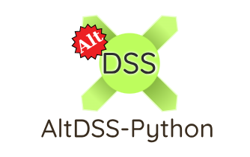
OpenDER Technology Considerations
OpenDer_interface: A work in progress API meant to manage Distributed Energy Resources with in DSS models.
Py_DSS_Interface Vs AltDSS
OpenDER_interface source code uses Py_DSS_Interface
AltDSS is faster and more efficient with larger circuits

Slide 18
Design
Notes:
Aditi

Slide 19
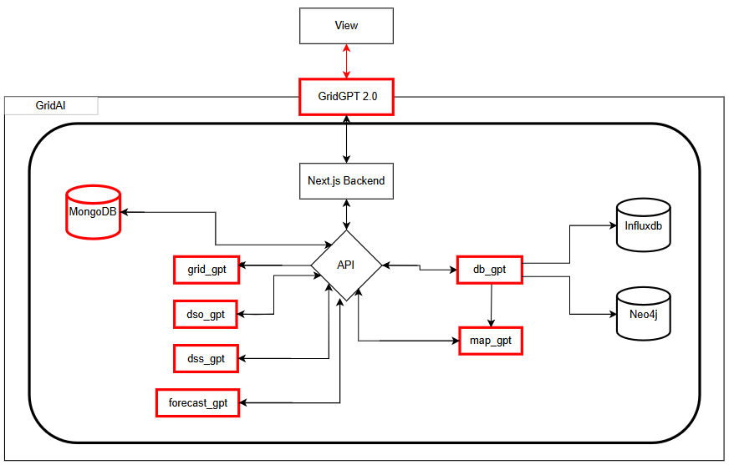
Design - GridGPT 2.0
Firebase
Notes:
Aditi, show gridAI architecture without gridGPT architecture first, show only the gridAI features we use in our diagram

Slide 20
The GPT’s
Notes:
Scott

Slide 21
dso_GPT
Use Case:
Aggregated DERs together to form Virtual Power Plants (VPPs)
Scrapes DER data from OpenDSS files
Implementation:
Use DER data to form VPPs
Uses generation data
Finds Groupings of DERs to Minimize this formula
Voltage Instability + Power Factor Instability + System Losses
Notes:
Scott

Slide 22
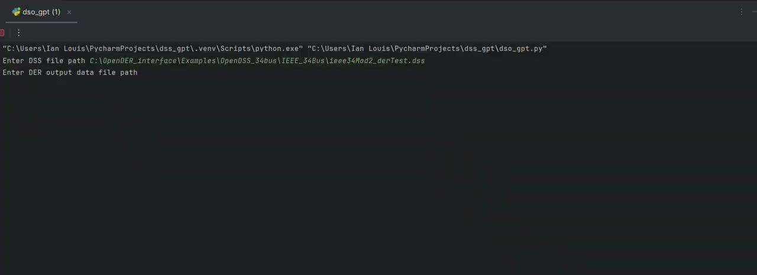
dso_GPT Demo

Slide 23
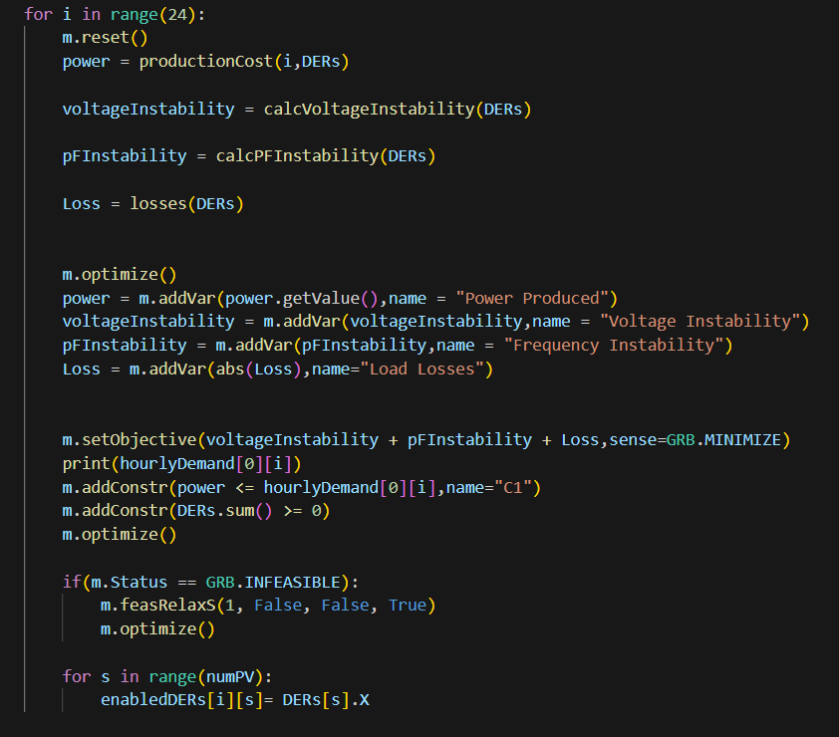
dso_GPT Optimization
This code is used to generate
the Virtual power plants.

Slide 24
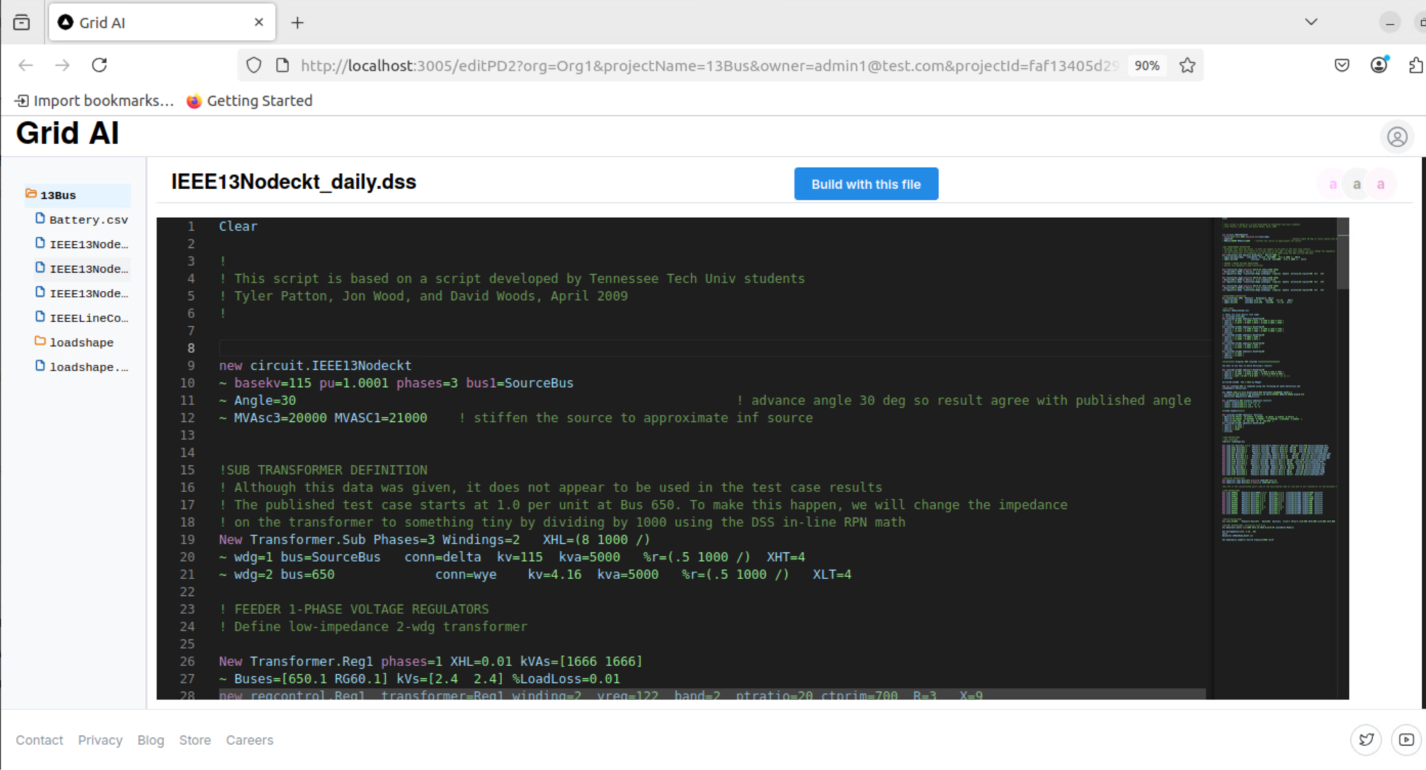
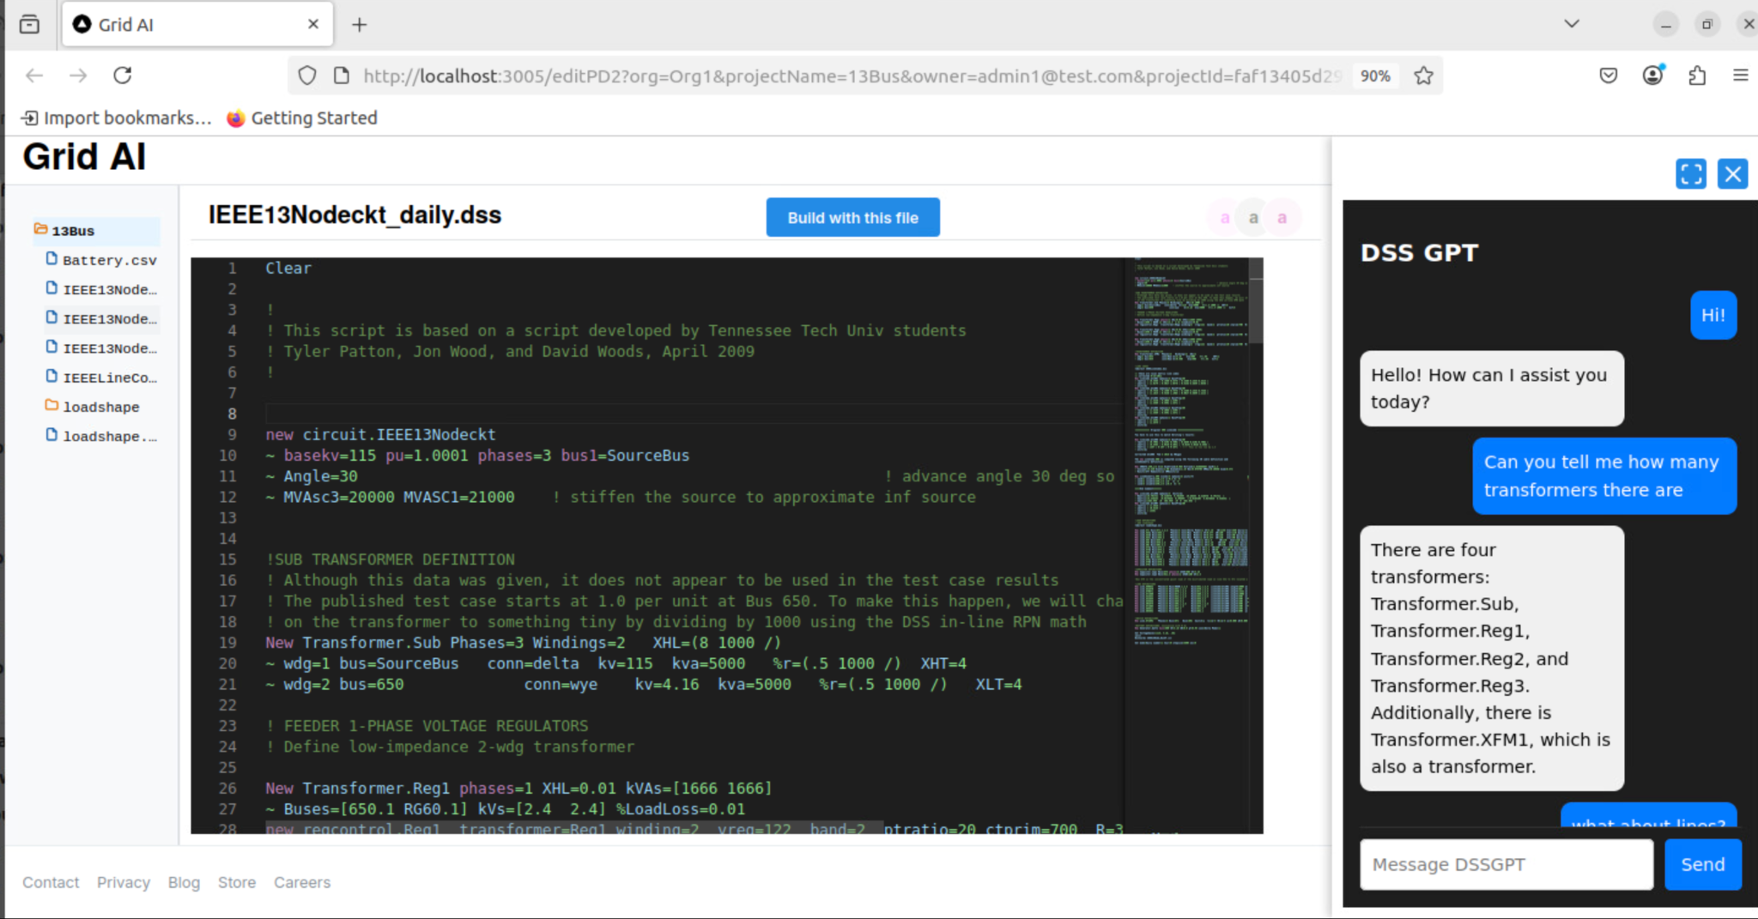
dss_GPT
Automates the job of editing and writing dss files
Users can ask specific questions about the DSS files that the user uploads
Notes:
Aditi - main goal - knowledge about model dss files based on user prompts and it directly edits those files and writes dss script files - automates the job

Slide 25
dss_GPT Demo
Notes:
Aditi - main goal - knowledge about model dss files based on user prompts and it directly edits those files and writes dss script files - automates the job

Slide 26
db_GPT
Use Case:
Retrieve data from Neo4j (Grid System)
Access key information about the grid model, including:
Power consumption
Load data
Voltage levels etc.
Implementation:
Uses LLM prompts to auto-generate database queries
Masks sensitive data before processing
Notes:
Bussan

Slide 27
db_GPT Demo

Slide 28
Next Steps
Notes:
Bussan

Slide 29
Next Steps
Create the other 3 GPTs:
Forecast_gpt: determines future load and capacity
grid_gpt: generic gpt that Interacts with other GPT models
map_gpt: interacts with GridAI’s 2d grid view
Optimize performance
Share ideas for enhancements and future integration

Slide 30
Individual Contributions
Notes:
Bussan
Add key takeaways (ur xpectations, ur experience)

Slide 31
Ian Bussan
Contributions:
Developed db_GPT
Prototypes scripts
Helped team with Git
Challenges
docker architecture
Implementation of AI tools
Notes:
Bussan - shrink the arch and highlight it

Slide 32
Ian Bussan
Technologies Learned:
Docker
Go
Neo4j
OpenAI
Takeaways:
Learned cutting edge technologies
Concepts useful for my career
Notes:
Bussan

Slide 33
Ian Louis
Contributions:
Created python script to read in DER output data from CSV files
Created python script to generate optimal Virtual Power Plant from DER data
New Technologies Learned:
altDSS python library
openDER python library
Gurobi Optimization python library
Gitlab
Notes:
Louis

Slide 34
Ian Louis
Challenges:
Learning new Python Libraries
Understanding Virtual Power Plants and why they are beneficial to the distribution system
Takeaways:
The software development process is more time consuming than I expected
AI will definitely be useful in managing power systems
The power grid will be experiencing drastic changes in the next 5-10 years
Notes:
Louis

Slide 35
Aditi Nachnani
Contributions:
Learned how to fine tune a model and context state management
Back end and frontend of dss_GPT
Challenges:
Understanding power grid terminology
Learning new tools: Go, Docker, LangChain, Firebase
Notes:
Aditi

Slide 36
Aditi Nachnani
New Technologies Learned:
Go
OpenAI’s API
Docker
LangChain
Firebase
Key Takeaways
Learned to manage timelines and document processes
Solidified a passion for AI and ML
Notes:
Aditi

Slide 37
Luke Eitzmann
Contributions:
Researched and Practiced the use of OpenDSS Software for grid modeling
Researched and Practiced the use of AltDSS Software to perform grid analysis calculations
AltDSS_interface
Reconstructed OpenDER_interface source code to use AltDSS functions
Meant to improve efficiency and accuracy of our gpt.
Notes:
Luke

Slide 38
Luke Eitzmann
Challenges:
Learning curve of OpenDSS and AltDSS Softwares
Conversions from Py_dss_interface to AltDSS
Technologies Learned:
AltDSS, OpenDER, OpenDER_Interface
OpenDSS
Python
Gitlab
Takeaways:
Learning new softwares and coding languages is more time consuming then I was prepared for.
The potential for AI in the field of power systems is immense.
Notes:
Luke

Slide 39
Scott Rininger
Contributions:
Completed Market Research on Distribution System Operators
Worked with AI team to understand Power Engineering
Helped the AI team implement dso_GPT
Worked on converting OpenDSS interface to altDSS interface
Challenges:
Learning about application design and procedure
Understanding the differences between DSOs and distribution management systems
Notes:
Scott

Slide 40
Scott Rininger
Technologies Learned:
Docker
Python
Gitlab
Takeaways:
Team cooperation is key on projects with specialists
AI is a useful tool but is hard to perfect
Notes:
Scott

Slide 41
Conclusion
The modern power grid is rapidly changing causing grid management issues for stakeholders
GridAI provides stakeholders with powerful software that allows them to solve these issues
GridGPT allows users to more easily leverage the power of GridAI to better manage their distribution grids
Notes:
Rininger

Slide 42
Works Cited
https://www.researchgate.net/publication/4164357_Optimisation_algorithm_for_a_virtual_power_plant_operation
https://ieeexplore.ieee.org/document/5534848
https://www.frontiersin.org/journals/energy-research/articles/10.3389/fenrg.2023.1152717/full
https://www.csrwire.com/press_releases/791866-adapting-utilities-harness-prosumer-power-renewable-energy-landscape
https://leaf-it.com/10-ways-prevent-cyber-attacks/
https://www.camus.energy/blog/what-is-a-distribution-system-operator
https://idw-online.de/de/attachmentdata44549.pdf
https://aemo.com.au/initiatives/major-programs/wa-der-program/about-the-wa-der-program
https://www.nationalgrid.co.uk/downloads-view-reciteme/660508
https://huggingface.co/docs
https://www.bv.com/perspectives/business-electricity-will-distribution-markets-dominate/
https://www.epri.com/events/C97292AF-0790-4514-B9DF-CCEF80D685E1
https://dss-extensions.org/AltDSS-Python/apidocs/altdss/altdss.Spectrum.html
https://sourceforge.net/p/electricdss/code/HEAD/tree/trunk/Training/Virtual-2022/
https://docs.gurobi.com/projects/optimizer/en/current/reference/python.html#secpython

Slide 43
Thank you!
Any questions?
Notes:
Add Conclusion

Slide 44
Extra Slides

Slide 45
Economic Improvements
Our solution is better than existing solutions because our LLM will be fine-tuned, which will eliminate errors and be more reliable. Our software will provide more in depth information about power grids and be less general like our competitors. By ensuring that the model is well-trained, we can eliminate any potential inaccuracies that other software might have. Moreover, this solution will be cheaper than other products since it does not use complex software, making it more appealing to customers.
Notes:
Scott - use the white space properly - put bullet points -change pic - delete the slide

Slide 46
Functionality
GridGPT will provide users with a more accessible and user friendly interface to use GridAI
GridGPT will successfully communicate between users and GridAI
Retrieve data from GridAI sent to GridGPT send to the user to answer the users questions
Backup Slide
Notes:
Bussan - will prioritixe 1 and then do it incrementally
This sem: designed the prototypes (conceptual - understanding how much time each takes)
Out of 6 we will prioritize x and then if time permits ….

Slide 47
Areas of Concern and Development
Integration with GridAI
Making a user friendly product
Delivering accurate information to user
Keeping the cost of GridGPT low
Notes:
Louis

Slide 48
Broader Area - Four Principles Chart
 | Beneficence | Nonmaleficence | Respect for Autonomy | Justice
Public Health, Safety, and Welfare | Improves usefulness of GridAI, to help design a more safe power system | Avoid inefficient management, of power | Lets users make own choices for design | Promotes personal benefits to all people
Global, cultural, and social | Provides safer more reliable power management | Does not negatively affect society | Lets users make decisions based on cultural norms | Does not have social bias when decision making
Environmental | Improved Power grouping can reduce carbon emissions. | Will likely cause an increase in carbon emission | You get to provide an eco friendly design option | Implementation would not disturb the environment
Economic | Can improve power production efficiency, saving money | Reduces human error, which saves companies money | You don’t have to buy gridGPT or gridAI to use openDSS | Would not unfairly financially affect any people
Notes:
Luke

Slide 49
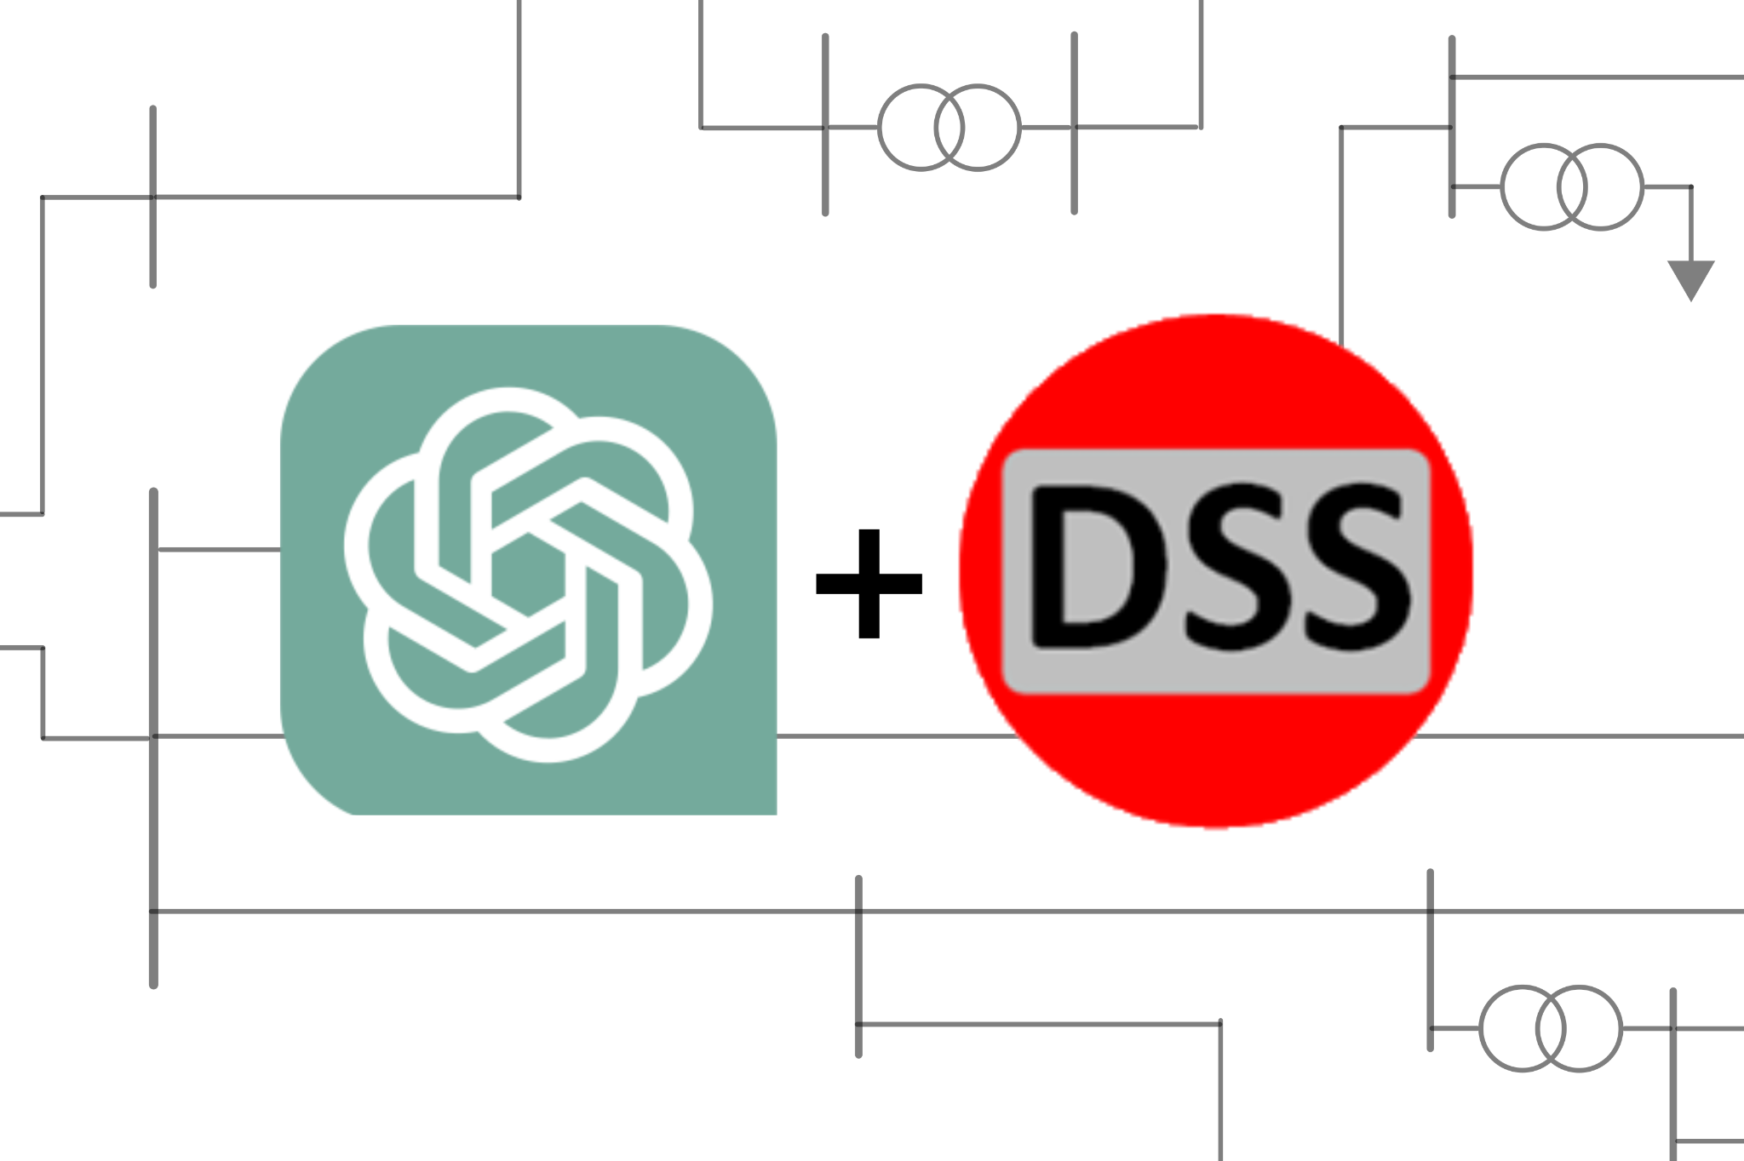
Technology Complexity Analysis
Internal complexity
Large number of technologies Involved (OpenAI, OpenDSS, Python)
Team unfamiliar with Technology (Never heard of OpenDSS)
We don’t have access to certain project requirements (GridAI)
External complexity
Lacking testable data
Lacking access to clients
Resources that are outside our understanding
Notes:
Bussan

Slide 50
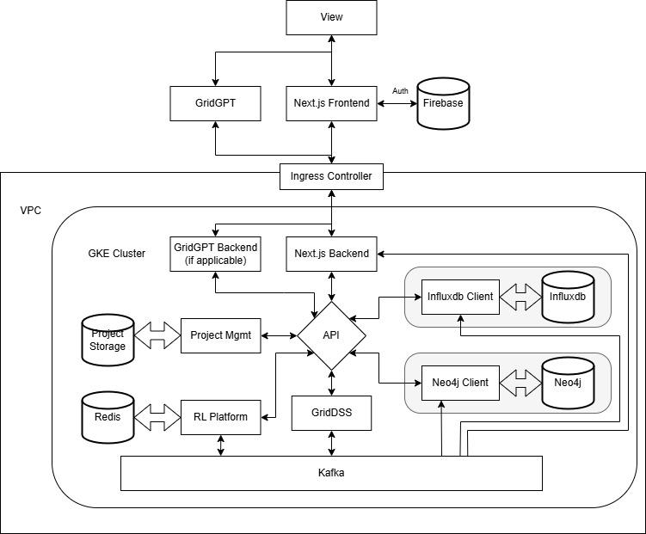
Detailed Design - GridAI
Notes:
Aditi

Slide 51
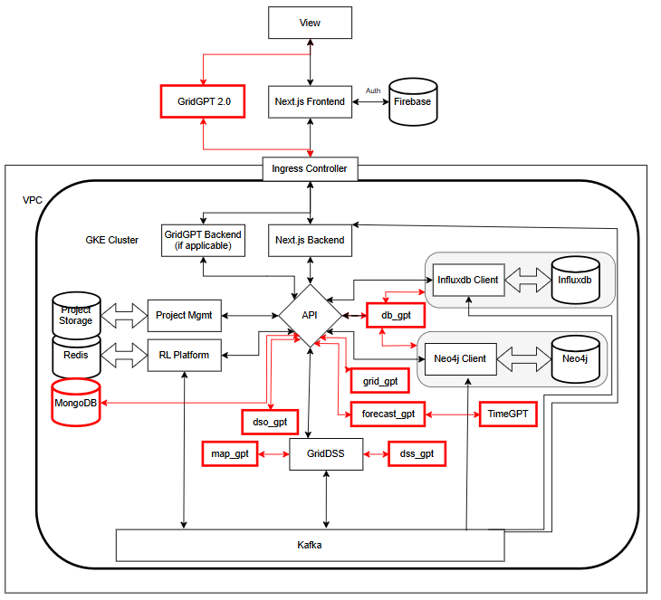
Detailed Design - GridAI + GridGPT 2.0
Firebase
Notes:
Aditi

Slide 52
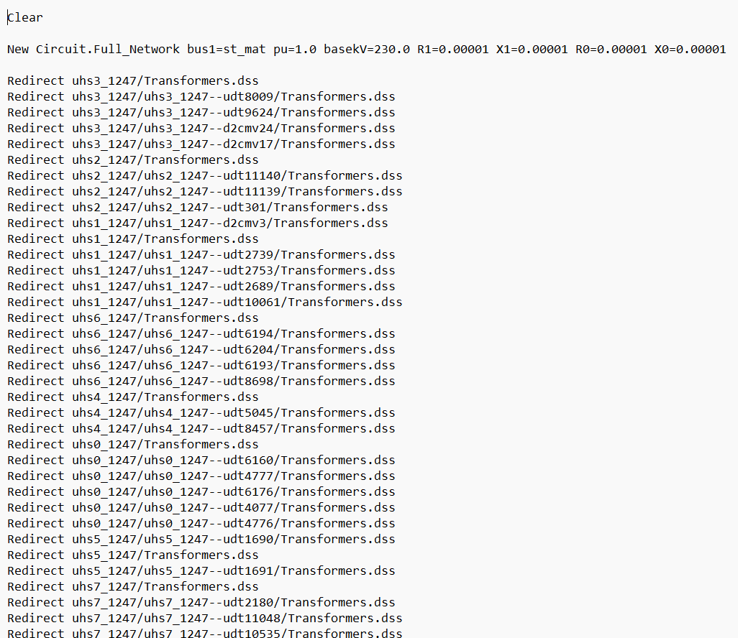
grid_GPT
Traditional ChatBot
Interacts with other GPT models
Answers users questions about the OpenDSS Model and data
Notes:
Louis, show the file icons of DSS fiels; GPT model interacts with other GPT model; add a block diagram

Slide 53
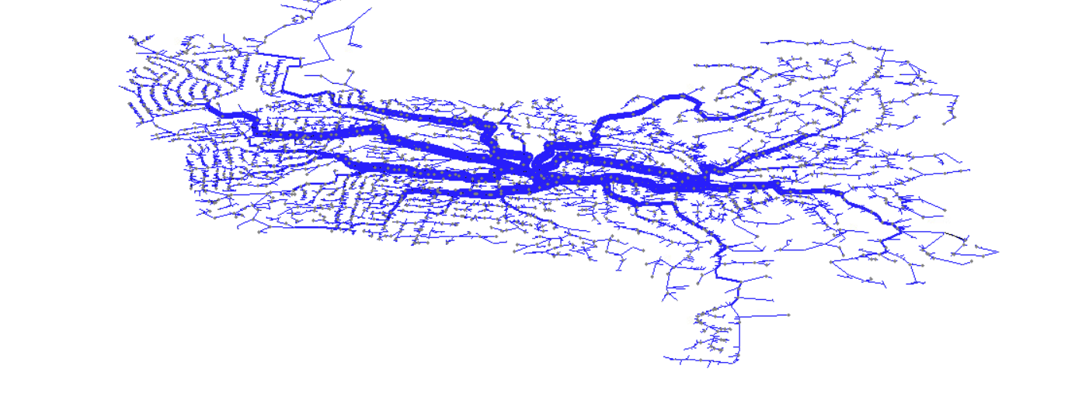
map_GPT
Adds more human interaction by allowing users to interact with the 2D grid
Ex: View only the substations in the distribution grid
OpenDSS Model View
GridAI 2D Grid View
Notes:
Aditi - more interaction - highlight max solar power - it can highlight on the map - map_GPT=more human interaction - highlight substations

Slide 54
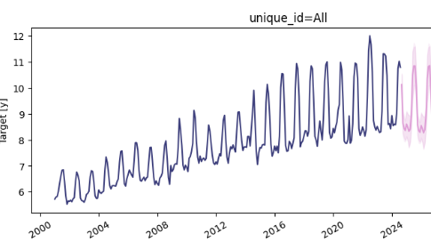
forcast_GPT
Use Case:
Forecasts the generations and demand of the system
DSO users determine future load and capacity
Implementation:
Use TimeGPT API to predict forecast
Convert data to Nixtla format for TimeGPT
Use TimeGPT predict multiple data characteristics
Localized demand
Weather Data
Usage Patterns
Local Energy Sources
Notes:
Bussan

Slide 55
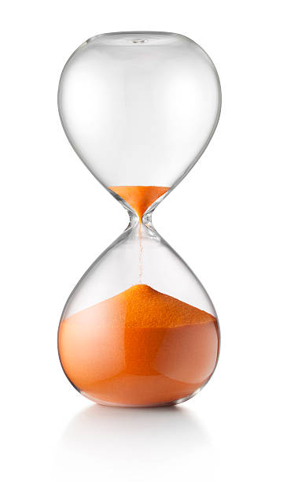
Why did we make only 3 GPTs
Time
A semester is only 16 weeks
Other classwork to balance
Complexity
This project was new to the team
Unfamiliar with GPTs and their operation

Slide 56
Milestones
Milestone 1: Perform market research and decide on the technology (eg: OpenAI vs. Gemini)
Milestone 2: Understand the given codebase of GridAI
Milestone 3: Create the GPTs to the desired specifications
Milestone 4: Test the GPTs to ensure accuracy and function
Milestone 5: A successful industry review panel
Notes:
Scott

